Slide 1















SHADAN WOMEN'S COLLEGE OF ENGINEERING AND TECHNOLOGY
[ An Autonomous Institution Affiliated to JNTUH ]
PARALLEL AND DISTRIBUTED OPERATING SYSTEMS
Presented by:
Amath urvRasheed U.A (24L51A0508)
Subject : Operating Systems
Class : B.tech 2nd year 2nd semester
Branch : CSE-A

Slide 2

INTRODUCTION
  An Operating System (OS) manages hardware and software resources.
  Advanced systems require high performance and scalability.
  Parallel OS and Distributed OS are designed to handle such needs.
  They improve speed, efficiency, and resource utilization.

Slide 3


Operating System
  An Operating System (OS) is a system software that manages computer hardware and software.
  It acts as an intermediary between the user and the hardware components.
Main functions include:
Process management
Memory management
File system management
Device management
  Examples include Windows, Linux, and macOS.

Slide 4
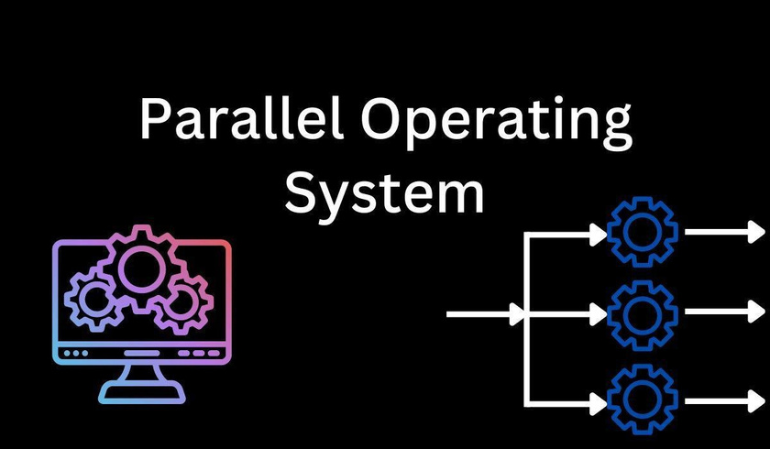

Parallel Operating System
  A Parallel Operating System is designed to manage multiple processors within a single system.
  It allows tasks to be divided into smaller parts and executed simultaneously.
  These systems are used in environments where speed and performance are critical.
  The processors share memory and communicate at high speed.

Slide 5
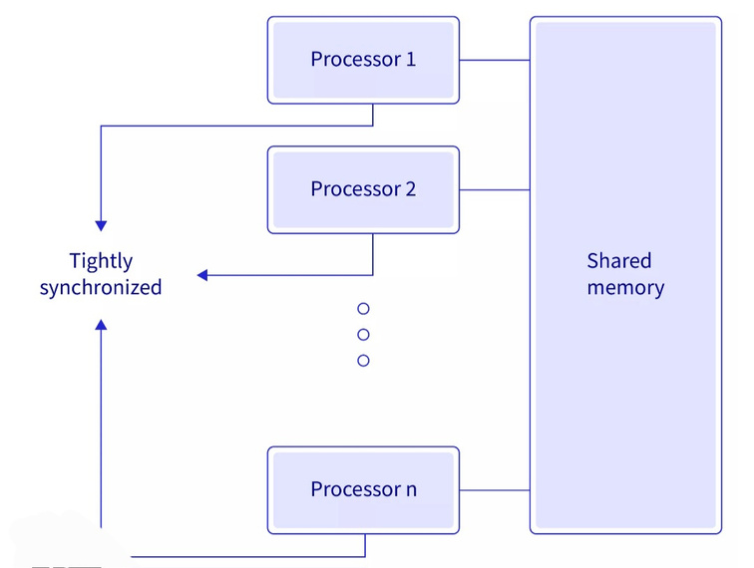
Features of Parallel OS
  Supports multiple CPUs working together in a coordinated way.
  Uses shared memory architecture, allowing all processors to access the same data.
  Provides fast communication between processors using internal connections.
  Implements efficient scheduling algorithms to distribute tasks.
  Ensures load balancing, so no processor remains idle.

Slide 6
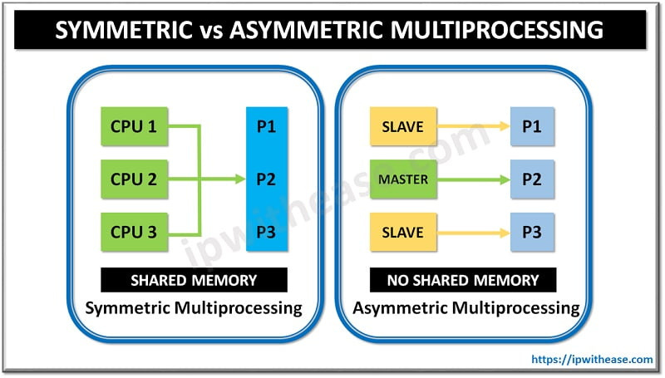
Types of Parallel Systems
  Symmetric Multiprocessing (SMP):
All processors are equal and perform similar tasks. Any processor can execute any process.
Example: Modern multi-core systems.
  Asymmetric Multiprocessing (AMP):
One processor acts as the master and controls others.Slave processors execute assigned tasks.Simpler but less flexible than SMP.

Slide 7

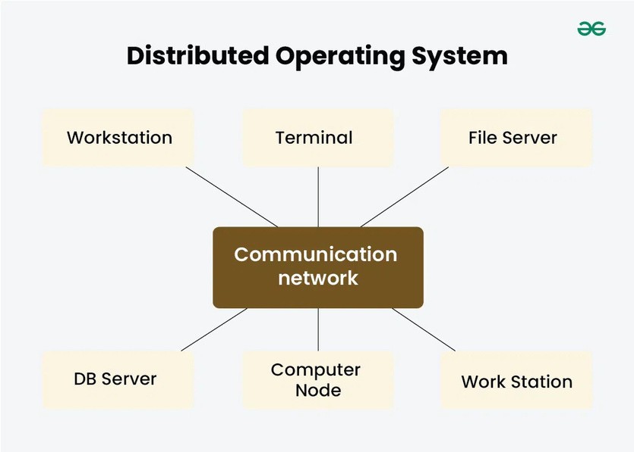


Distributed Operating System
  A Distributed Operating System manages multiple independent computers connected via a network.
  Each system has its own memory and processor.
  The OS provides a single system image, making all machines appear as one.
  Communication between systems is done using message passing.

Slide 8


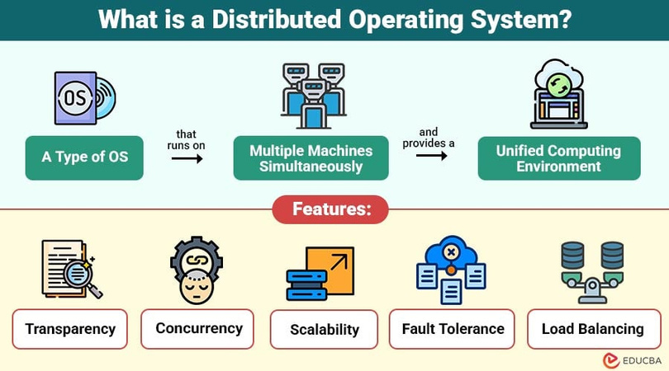


Features of Distributed OS
  Enables resource sharing such as files, printers, and applications.
  Provides transparency, hiding the complexity of multiple systems.
  Offers scalability, allowing easy addition of new systems.
  Supports fault tolerance, ensuring system reliability.
  Uses network communication protocols for coordination.

Slide 9
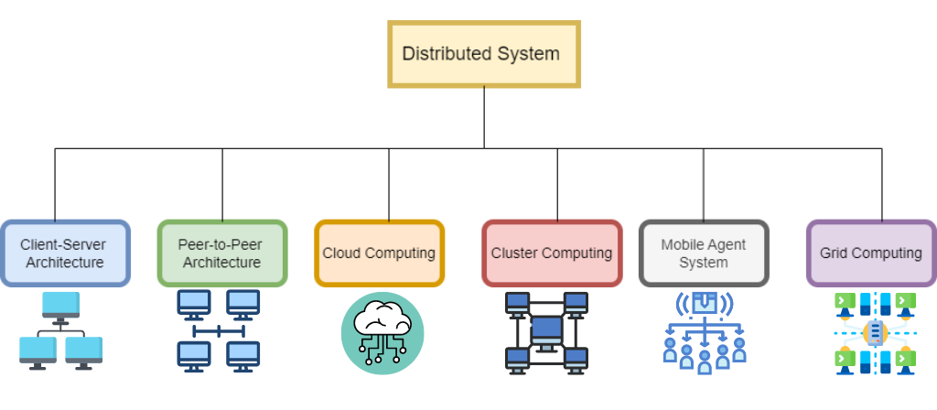
Types of Distributed Systems
  Client-Server Systems:
Clients request services, and servers provide them.
  Peer-to-Peer Systems:
All nodes are equal and share resources directly.
  Clustered Systems:
Multiple systems work together as a single unit for performance.

Slide 10
Applications of parallel and distributed operating systems :
  Weather prediction systems
  Scientific simulations
  Artificial Intelligence and Machine Learning
  Graphics rendering and gaming
  High-performance computing systems
  Cloud computing platforms

Slide 11
CONCLUSION
  Parallel and Distributed Operating Systems are essential for modern computing.
  They provide improved performance, scalability, and reliability.
  These systems are widely used in industries and research.
  Understanding these concepts is important for future technologies.

Slide 12
Thank you!

